Slide 1
Data Communications

Slide 2
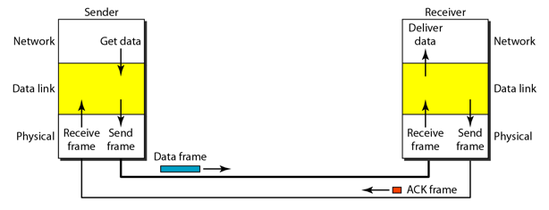
HIGH-LEVEL DATA LINK CONTROL (HDLC)
Data link control protocol.
Developed by ISO.
Basis for many other important data link control protocols.
.

Slide 3
HIGH-LEVEL DATA LINK CONTROL (HDLC)
Basic Characteristics
HDLC defines
three types of stations,
two link configurations, and
three data transfer modes of operation.
.

Slide 4
HIGH-LEVEL DATA LINK CONTROL (HDLC)
The three station types are
Primary station:
Responsible for controlling the operation of the link.
Frames issued by the primary are called commands.
Secondary station:
Operates under the control of the primary station.
Frames issued by a secondary are called responses.
The primary maintains a separate logical link with each secondary station on the line.
Combined station:
Combines the features of primary and secondary.
A combined station may issue both commands and responses.
.

Slide 5
HIGH-LEVEL DATA LINK CONTROL (HDLC)
The two link configurations are
Unbalanced configuration: Consists of one primary and one or more secondary stations and supports both full-duplex and half-duplex transmission.
Balanced configuration: Consists of two combined stations and supports both full-duplex and half-duplex transmission.
.

Slide 6
HIGH-LEVEL DATA LINK CONTROL (HDLC)
The three data transfer modes are
Normal response mode (NRM):
Used with an unbalanced configuration.
The primary may initiate data transfer to a secondary, but a secondary may only transmit data in response to a command from the primary.
Asynchronous balanced mode (ABM):
Used with a balanced configuration.
Either combined station may initiate transmission without receiving permission from the other combined station.
Asynchronous response mode (ARM):
Used with an unbalanced configuration.
The secondary may initiate transmission without explicit permission of the primary.
The primary still retains responsibility for the line, including initialization, error recovery, and logical disconnection.
.

Slide 7
HIGH-LEVEL DATA LINK CONTROL (HDLC)
Basic Characteristics
NRM is used on multidrop lines, in which a number of terminals are connected to a host computer.
The computer polls each terminal for input.
ABM is the most widely used : it makes more efficient use of a full-duplex point-to-point link because there is no polling overhead.
ARM is rarely used; it is applicable to some special situations in which a secondary may need to initiate transmission.
.

Slide 8
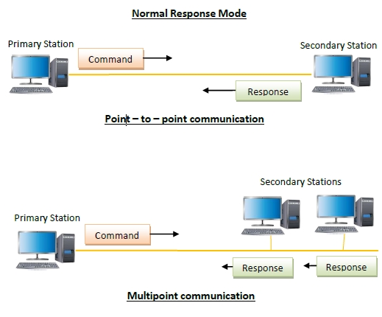
HIGH-LEVEL DATA LINK CONTROL (HDLC)
.

Slide 9
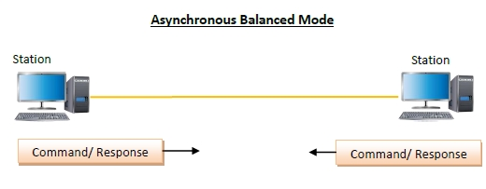
HIGH-LEVEL DATA LINK CONTROL (HDLC)
.

Slide 10
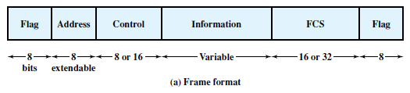
HIGH-LEVEL DATA LINK CONTROL (HDLC)
Frame Structure
Header : The flag, address, and control fields before the information field.
Trailer : The FCS and flag fields following the information field.
.

Slide 11
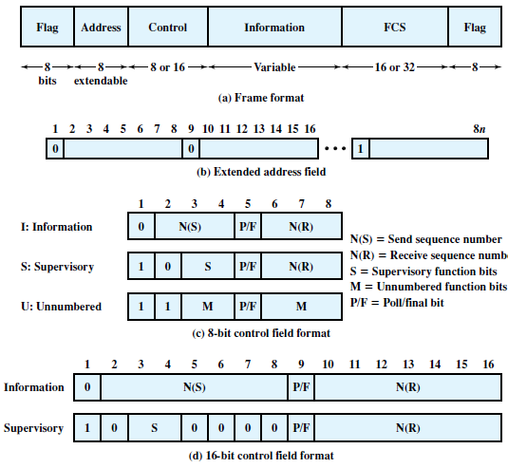
HIGH-LEVEL DATA LINK CONTROL (HDLC)
Frame Structure
.

Slide 12
HIGH-LEVEL DATA LINK CONTROL (HDLC)
Flag Fields
Flag fields delimit the frame at both ends with the unique pattern 01111110.
A single flag may be used as the closing flag for one frame and the opening flag for the next.
flag sequence to synchronize on the start of a frame.
.

Slide 13
HIGH-LEVEL DATA LINK CONTROL (HDLC)
Flag Fields
Appearance of pattern 01111110 somewhere inside the frame destroy synchronization.
.

Slide 14
HIGH-LEVEL DATA LINK CONTROL (HDLC)
Solution : bit stuffing .
@ sender :
For all bits between the starting and ending flags, the transmitter inserts an extra 0 bit after each occurrence of five 1s in the frame.
@Receiver
When a pattern of five 1s appears, the sixth bit is examined.
If this bit is 0, it is deleted. If the sixth bit is a 1 and the seventh bit is a 0, the combination is accepted as a flag.
This property is known as data transparency.
.

Slide 15
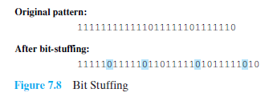
HIGH-LEVEL DATA LINK CONTROL (HDLC)
In the first two cases, the extra 0 is not strictly necessary.
but is necessary for the operation of the algorithm.
.

Slide 16

HIGH-LEVEL DATA LINK CONTROL (HDLC)
Address Field
Identifies the secondary station.
Not needed for point-to-point links but included for the sake of uniformity.
Usually 8 bits long, an extended format may be used.
The leftmost bit of each octet is 1 or 0.
The remaining 7 bits of each octet form part of the address
.

Slide 17
HIGH-LEVEL DATA LINK CONTROL (HDLC)
Frame Structure : Address Field
The address 11111111 is used to allow the primary to broadcast.
.

Slide 18
HIGH-LEVEL DATA LINK CONTROL (HDLC)
Frame Structure : Control Field
Defines 3 types of frames, each with a different control field format.
Information frames (I-frames).
Supervisory frames (S-frames) provide the ARQ mechanism when piggybacking is not used.
Unnumbered frames (U-frames) provide supplemental link control functions.
.

Slide 19
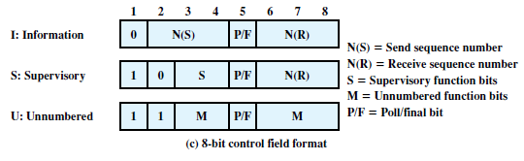
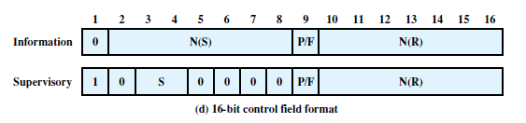
HIGH-LEVEL DATA LINK CONTROL (HDLC)
Control Field
The first one or two bits of the control field serves to identify the frame type.
.

Slide 20
HIGH-LEVEL DATA LINK CONTROL (HDLC)
Control Field
poll/final (P/F) bit.
In command frames, P bit is set to 1 to solicit (poll) a response frame.
In response frames, F bit set to 1 to indicate the response frame transmitted as a result of a soliciting command.
.

Slide 21
HIGH-LEVEL DATA LINK CONTROL (HDLC)
Control Field
The basic control field for S- and I-frames uses 3-bit sequence numbers.
With the appropriate set-mode command, an extended control field can be used for S- and I-frames that employs 7-bit sequence numbers.
U-frames always contain an 8-bit control field.
.

Slide 22
HIGH-LEVEL DATA LINK CONTROL (HDLC)
Information Field
The information field is present only in I-frames and some U-frames.
consist of an integral number of octets.
The length is variable up to some system defined maximum.
Frame Check Sequence Field
FCS is an error detecting code calculated from the remaining bits of the frame, exclusive of flags.
.

Slide 23
HIGH-LEVEL DATA LINK CONTROL (HDLC)
Frame Structure : Operation
Consists of the exchange of I-frames, S-frames, and U-frames between two stations.
Various commands & responses defined for these frame types are listed in Table 7.1..
.

Slide 24
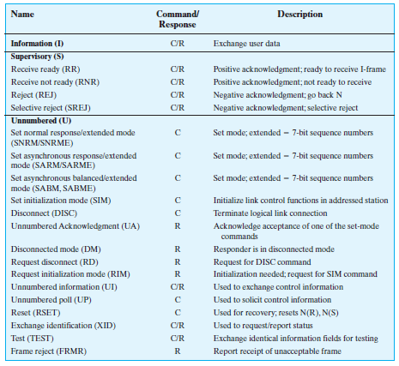
HIGH-LEVEL DATA LINK CONTROL (HDLC)
Frame Structure
Operation
Table 7.1 HDLC Commands and Responses
.

Slide 25
HIGH-LEVEL DATA LINK CONTROL (HDLC)
Operation
The operation of HDLC involves three phases.
Initialization : During this phase, the options that are to be used are agreed upon.
Exchange : the two sides exchange user data and the control information to exercise flow and error control.
Termination : one of the two sides signals the termination of the operation.
.

Slide 26
HIGH-LEVEL DATA LINK CONTROL (HDLC)
Frame Structure : Operation
Initialization
@sender
Either side may request initialization by issuing one of the six setmode commands.
This command serves 3 purposes:
It signals the other side that initialization is requested.
It specifies which of the three modes (NRM, ABM, ARM) is requested.
It specifies whether 3- or 7-bit sequence numbers are to be used.
SNRM, SNRME
SARM, SARME
SABM, SABME
.

Slide 27
HIGH-LEVEL DATA LINK CONTROL (HDLC)
Frame Structure : Operation
Initialization
@Receiver
If the other side accepts this request, then it transmits an unnumbered acknowledged (UA) frame back to the initiating side.
If the request is rejected, then a disconnected mode (DM) frame is sent.
UA
DM
.

Slide 28
HIGH-LEVEL DATA LINK CONTROL (HDLC)
Frame Structure
Data Transfer
When the initialization is accepted, then a logical connection is established.
Both sides may send user data in Iframes, starting with sequence number 0.
The N(S) and N(R) fields of the I-frame are sequence numbers that support flow control and error control.
N(R) is the acknowledgment for I-frames received;
it enables the HDLC module to indicate which number I-frame it expects to receive next.
.

Slide 29
HIGH-LEVEL DATA LINK CONTROL (HDLC)
Data Transfer
S-frames are also used for flow control and error control.
The receive ready (RR) frame acknowledges the last I-frame received by indicating the next I-frame expected.
Receive not ready (RNR) acknowledges an I-frame, as with RR, but also asks the peer entity to suspend transmission of I-frames.
When the entity that issued RNR is again ready, it sends an RR.
RR
RNR
.

Slide 30
HIGH-LEVEL DATA LINK CONTROL (HDLC)
Frame Structure
Data Transfer
REJ initiates the go-back-N ARQ.
It indicates that the last I-frame received has been rejected and that retransmission of all I-frames beginning with number N(R) is required.
Selective reject (SREJ) is used to request retransmission of just a single frame.
REJ
SREJ
.

Slide 31
HIGH-LEVEL DATA LINK CONTROL (HDLC)
Disconnect
Either HDLC module can initiate a disconnect, if there is some sort of fault, or at the request of its higher-layer user.
HDLC issues a disconnect by sending a disconnect (DISC) frame.
The remote entity must accept the disconnect by replying with a UA and informing its layer 3 user that the connection has been terminated.
DISC
.

Slide 32
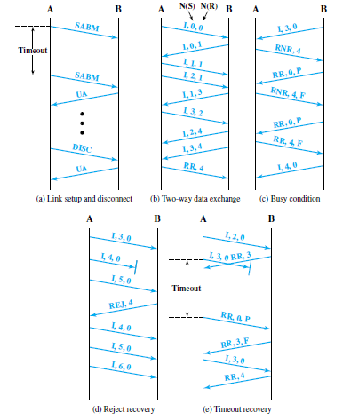
HIGH-LEVEL DATA LINK CONTROL (HDLC)
Examples of Operation
Figure 7.9 Examples of HDLC Operation
.

Slide 33
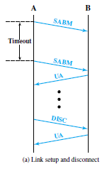
HIGH-LEVEL DATA LINK CONTROL (HDLC)
Figure 7.9a shows the frames involved in link setup and disconnect.
.

Slide 34
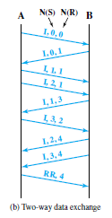
HIGH-LEVEL DATA LINK CONTROL (HDLC)
Figure 7.9b illustrates the full-duplex exchange of I-frames.
.

Slide 35
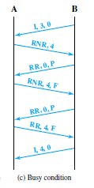
HIGH-LEVEL DATA LINK CONTROL (HDLC)
Figure 7.9c shows an operation involving a busy condition.
.

Slide 36

HIGH-LEVEL DATA LINK CONTROL (HDLC)
Figure 7.9d shows error recovery using the REJ command.
.

Slide 37
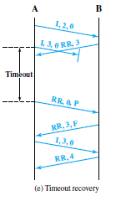
HIGH-LEVEL DATA LINK CONTROL (HDLC)
Error recovery using a timeout is shown in Figure 7.9e.
.

Slide 38
A system uses the Go Back – N ARQ Protocol. If each frame carries 1000 bits of data, how long does it take to send 1 million bits of data if the distance between the sender and receiver is 5000 Km and the propagation speed is 2 x 10⁸ m?
Consider window size of 7.Ignore the overhead due to the header and trailer. (Assume transmission time of frame=1ms)
Ignore waiting, and processing delays. Assume no data or control frame is lost or damaged.
solution
Tprop = 5000x10³ / 2x10⁸ = 25 ms
We need to send w = 7 frame.
1000000/7000 = 143 windows
Trnsmission time of window = 7 x 1ms = 7ms
Delay for 1 window = t_{wframe} + 2 t_{prop}
₌ ₇ ₊₅₀
Delay for 143 windows = 143 X 57 ms
_{= 8.1 second}
.

Slide 39
Using 5-bit sequence numbers, what is the maximum size of the sender windows for each of the following protocols?
a. Stop-and-Wait ARQ ans : 1
b. Go-Back-NARQ 2⁵ - 1
c. Selective-Repeat ARQ 2₅₋₁
.

Slide 40
A sender sends a series of frame to the same destination using 5-bit sequence numbers. If the sequence number starts with 0, what is the sequence number after sending 100 frame?
101%32 = 5
.

Slide 41
A. Consider a scenario where the receiver expecting 5th frame and sending receive ready frame to the sender. Write the 8 bit control field (in binary) of HDLC acknowledgement frame for the same.
.

Slide 42
B Consider a scenario where the receiver is busy and already received 4 frame. The receiver sends receive not ready frame to the sender. Write the 8 bit control field (in binary) of HDLC acknowledgement frame for the same.
.

Slide 43
C Consider a scenario where the sender is sending a 5th frame, which is damaged and not received. When it receives a subsequent frames, it replies to the sender by sending the REJ frame to the sender. Write the 8 bit control field (in binary) of HDLC frame for frame sent by the receiver the same. ( Assume Go Back N error control mechanism is used )
.

Slide 44
D Consider a scenario where the sender is sending a 5th frame, which is damaged and not received. When it receives a subsequent frame, it replies to the sender by sending the SREJ frame to the sender. Write the 8 bit control field (in binary) of HDLC frame for frame sent by the receiver the same. ( Assume Selective Reject error control mechanism is used )
.

Slide 45
END
16
.

